Slide 1


CS 1371 Computing for Engineers
Programming in Matlab Environment
Dr. Mary Hudachek-Buswell

Slide 2
The Most Important Topic Ever Computation Complexity or Big O

Slide 3
Computation Complexity
Measuring the efficiency of an algorithm in terms of space(memory) and time(speed)
Efficiency is expressed a function of the input size
“Big-O” notation -- O(f(n))
Generally looks at worst case, ie longest time and most space used

Slide 4
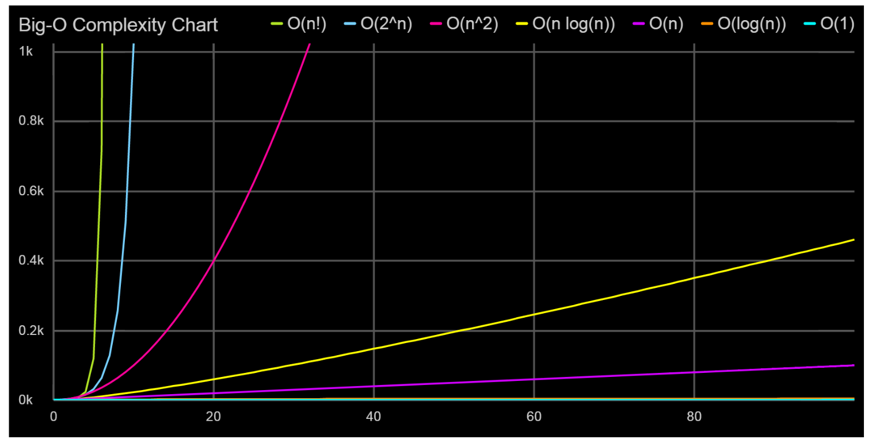
Complexity Classes: O(1), O(log n), O(n), O(n log n), O(n^2), O(2^n), O(n!)

Slide 5
Time complexity
Tends to be looked at as more important
Assume that each operation takes one unit of time to process.
Measuring:
Additive Property: O(m) + O(n) = O(max(n,m))
Multiplicative Property: Loops the sum of the statements inside the loop

Slide 6
Complexity of Loops Example
for i = 1:n
for j = 1:n
x = x + 1
O(n*n) = O(n^2)

Slide 7
Sorting Algorithms Famous Big O Examples
Bubble sort
Insertion/Selection Sort
Merge sort
Quick Sort

Slide 8
Bubble Sort
Compare two adjacent elements, if the first greater than the second, then swap them and continue.

Slide 9
Example of Bubble Sort
7
2
8
5
4
2
7
5
4
8
2
5
4
7
8
2
4
5
7
8
2
7
8
5
4
2
7
5
4
8
2
5
4
7
8
2
4
5
7
8
2
7
8
5
4
2
5
7
4
8
2
4
5
7
8
(done)
2
7
5
8
4
2
5
4
7
8
2
7
5
4
8
O(n^2)

Slide 10
Selection Sort
Given an array of length n,
Search elements 0 through n-1 and select the smallest
Swap it with the element in location 0
Search elements 1 through n-1 and select the smallest
Swap it with the element in location 1
Search elements 2 through n-1 and select the smallest
Swap it with the element in location 2
Search elements 3 through n-1 and select the smallest
Swap it with the element in location 3
Continue in this fashion until there’s nothing left to search

Slide 11
Example and analysis of Selection Sort
The Selection Sort might swap an array element with itself--this is harmless, and not worth checking for
Analysis:
The outer loop executes n-1 times
The inner loop executes about n/2 times on average (from n to 2 times)
Work done in the inner loop is constant (swap two array elements)
Time required is roughly (n-1)*(n/2)
You should recognize this as O(n²)
7
2
8
5
4
2
7
8
5
4
2
4
8
5
7
2
4
5
8
7
2
4
5
7
8

Slide 12
Insertion sort
The outer loop of insertion sort is: for (outer = 1; outer < a.length; outer++) {...}
The invariant is that all the elements to the left of outer are sorted with respect to one another
For all i < outer, j < outer, if i < j then a[i] <= a[j]
This does not mean they are all in their final correct place; the remaining array elements may need to be inserted
When we increase outer, a[outer-1] becomes to its left; we must keep the invariant true by inserting a[outer-1] into its proper place
This means:
Finding the element’s proper place
Making room for the inserted element (by shifting over other elements)
Inserting the element

Slide 13
One step of insertion sort
sorted
next to be inserted
3
4
7
12
14
14
20
21
33
38
10
55
9
23
28
16
temp
less than 10
10
10
12
21
3
12
14
14
14
20
33
33
38
4
7
14
20
21
38
10
55
9
23
28
16
sorted
O(n^2)

Slide 14
Analysis of insertion sort
We run once through the outer loop, inserting each of n elements; this is a factor of n
On average, there are n/2 elements already sorted
The inner loop looks at (and moves) half of these
This gives a second factor of n/4
Hence, the time required for an insertion sort of an array of n elements is proportional to n²/4
Discarding constants, we find that insertion sort is O(n²)

Slide 15
Merge Sort
Merge sort is based on the divide-and-conquer paradigm. Its worst-case running time has a lower order of growth than insertion sort.

Slide 16
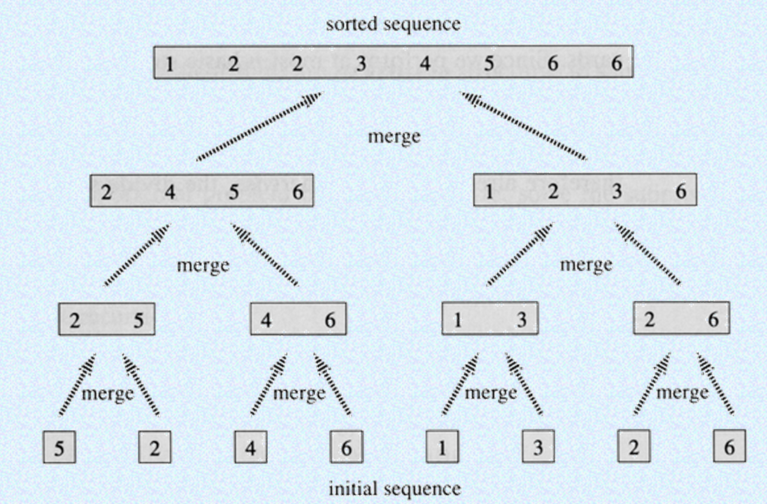
Merge Sort
O(n log(n))

Slide 17
Typical Exam Question: Match Big O's and Algorithms
Big O
Algorithm
O(1)
O(log n)
O(n log n)
O(n²)
2 Nested for loops
Merge Sort
Binary search
Min value in sorted array

Slide 18
Summary
Bubble Sort, Selection Sort, and Insertion Sort are all O(n²)
As we will see later, we can do much better than this with somewhat more complicated sorting algorithms
Within O(n²),
Bubble Sort is very slow, and should probably never be used for anything
Selection Sort is intermediate in speed
Insertion Sort is usually the fastest of the three--in fact, for small arrays (say, 10 or 15 elements), insertion sort is faster than more complicated sorting algorithms
Selection Sort and Insertion Sort are “good enough” for small arrays
Use of a Bubble Sort tends to elicit derision from your colleagues

Slide 19
Bubble Sort
function dataOut = bubbleSort(data)
lenD = size(data,2);
for i = 1:lenD
for j = (lenD):-1:(i+1)
if(data(j)<data(j-1))
tmp = data(j);
data(j)=data(j-1);
data(j-1)=tmp;
end
end
end
dataOut = data;

Slide 20
Insertion Sort
function dataOut = insertionSort(data) data=30263 03263 02363
len = size(data,2); len=5
for j = 2:len; j=2 j=3 j=4
key = data(j); key=0 key=2
i = j-1; i=1 i=2
while(i>0 && data(i)>key) true true
data(i+1) = data(i); d2=3 d3=3
i = i-1; i=0 i=1
data(i+1)=key; d1=0 d2=2
end
end
dataOut = data;

Slide 21
Merge Sort
function dataOut = mergeSort(data)
lenD = size(data,2);
if(lenD<2)
dataOut = data;
else
middle = cast(floor(lenD/2),'uint16');
L = data(1:middle);
R = data(middle+1:end);
L = mergeSort(L);
R = mergeSort(R);
dataOut = merge(L, R);
end
function dataOut = merge(L,R)
lenL = size(L,2);
lenR = size(R,2);
i = 0;
j = 0;
merged = [];
while(i<lenL||j<lenR)
if (i<lenL && j<lenR)
if(L(i+1)<=R(j+1))
merged(i+j+1) = L(i+1);
i = i+1;
else
merged(i+j+1) = R(j+1);
j = j+1;
end
elseif(i<lenL)
merged(i+j+1) = L(i+1);
i = i+1;
elseif(j<lenR)
merged(i+j+1) = R(j+1);
j = j+1;
end
end
dataOut = merged;

Slide 22
Quick Sort
function dataOut = quickSort(data)
lenD = size(data,2);
ind = cast(floor(lenD/2),'uint8');
j = 1;
k = 1;
L = [];
R = [];
if(lenD<2)
dataOut = data;
else
pivot = data(ind);
for i=1:lenD
if(i~=ind)
if(data(i)<pivot)
L(j) = data(i);
j = j+1;
else
R(k) = data(i);
k = k+1;
end
end
end
L = quickSort(L);
R = quickSort(R);
dataOut = [L pivot R];
end

